Slide 1
Marino Center
AIM Statement
Closing the loop with specialty labs. Our AIM is to close 90% within 30 business days
TEAM MEMBERS
Leonid Gordin, MD – Holistic Medicine
Lucille Shore-Schein, MD – Rheumatology
Carleen Mellon – Lead Admin Assistant
Guerline Maingrette – Admin Assistant
Elaine Kerrigan – Practice Manager
Marguerite Herrie – Practice Director / Coach

Slide 2
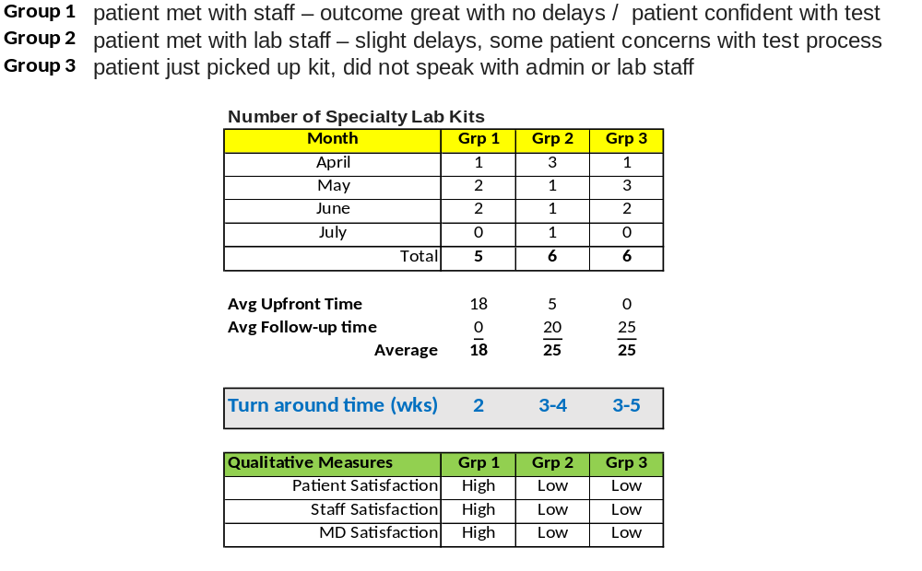
Notes:
We identified a problem with patients not getting thorough explanation of specialty tests. Tests were incomplete or delayed, patients were confused and frustrated. Staff spent a lot of time on the phone troubleshooting.

Slide 3
Lessons Learned
By meeting with patients to explain the test, problems, frustration, and delay in testing was eliminated.
  Patients were happier, staff was happier, as phone volume and patient complaints decreased.
  Doctors received results in a timely manner and were able to treat their patients.
Surprise – Amount of time needed to explain kits.

Slide 4
Questions?

